Slide 1


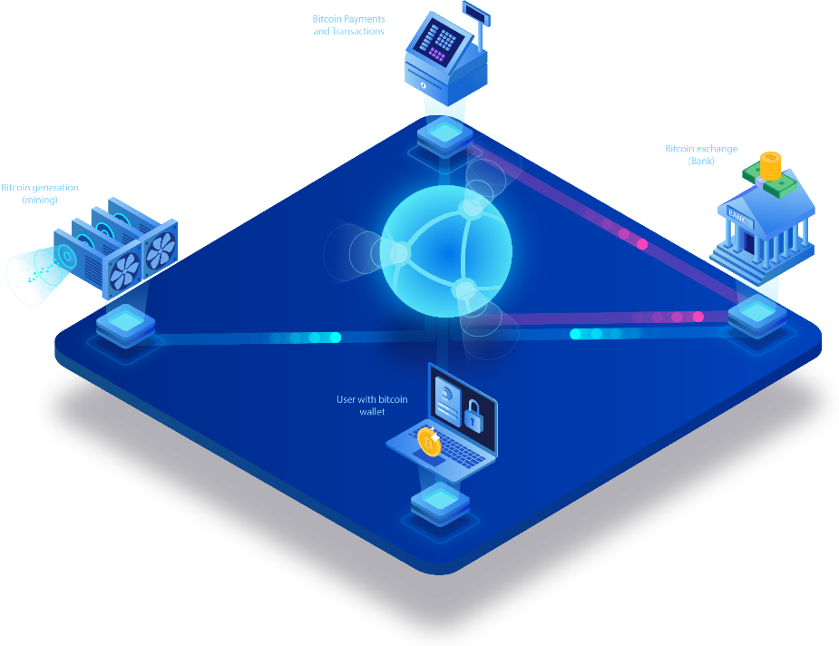
Tech Day 2019
BLOCKCHAIN AND ITS APPLICATIONS IN LOGISTICS
Presented by: Thanh Tung – Thanh Phuong
DC17 – R&D Team

Slide 2

CONTENTS
1
Problem
2
Solution
Some issues in reality Logistics status
Come up with resolution to this problem
3
Technical Architecture
4
Discussion – Q&A
Introduce about an idiea using blockchain technology
Questions & Answers

Slide 3

01
PROBLEM
Some issues that we may face with when using online shopping and its logistics service

Slide 4






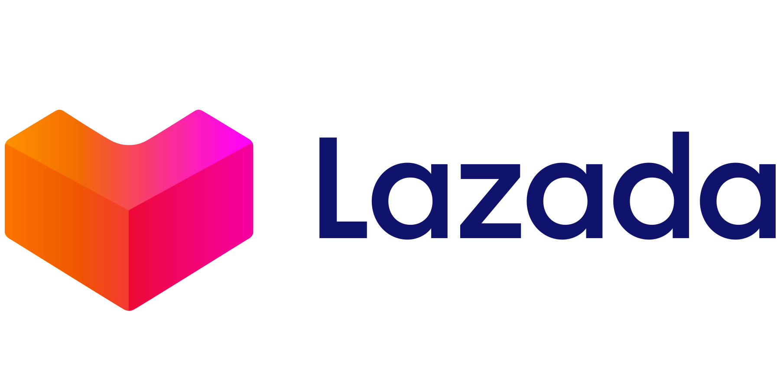

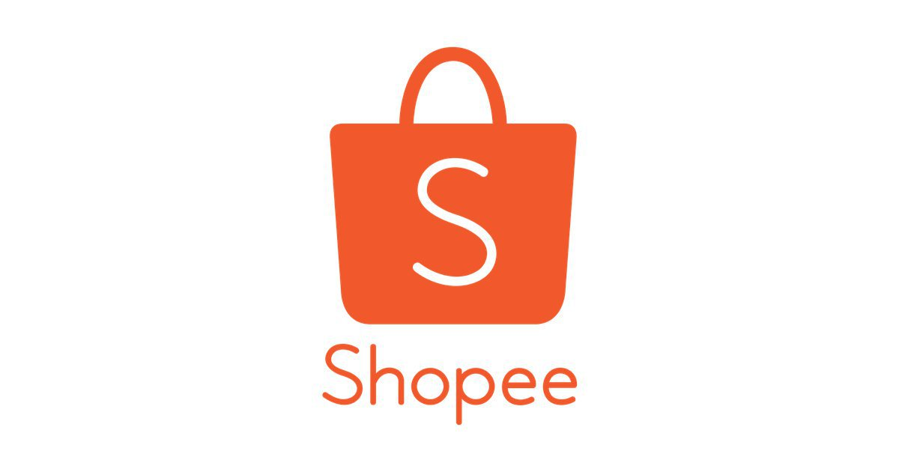





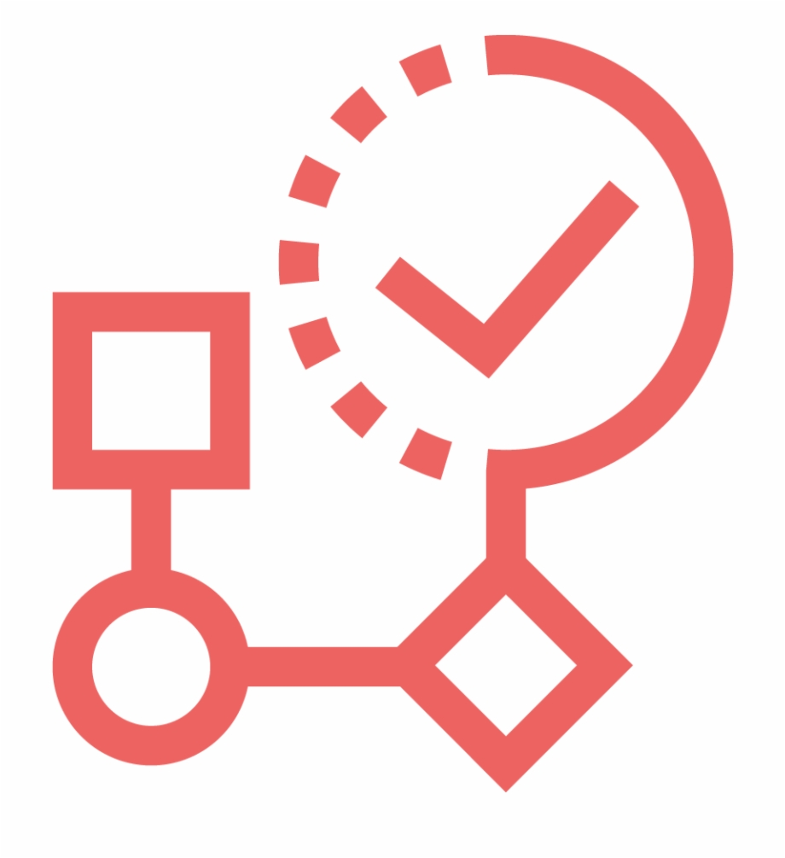

> 65%
now
2020
64 million internet users, accounting for 66% of the population
35% - 40%
in early 2020
2018
One-third (1/3) of the population, or 30 million Vietnamese, have been buying online, especially in 2018.
Vietnamese Consumers
On average, each Vietnamese person possesses 1.5 devices connected to the internet.
According to the management of Vietnam, e-commerce growth rate of Vietnam will reach about 30%, however, this figure is actually above 35% and can reach the level more than 40% in the coming years.
Online Shopping
original?
quality and its approve?
scam? fake? counterfeiters?
process status?
location?

Slide 5


Why Logistics ? Why Online Shopping?
POPULARITY
More and more people use it.
STRONG GROWTH - INCREASE
Significant development, growth up with a huge numbers.
ACTUAL DEMAND – THE NEED
Ensuring right and trust from consumers.
APPLY NEW TECHNOLOGY
Approach with new technology development, a good opportunity for both developers and enterprises.

Slide 6
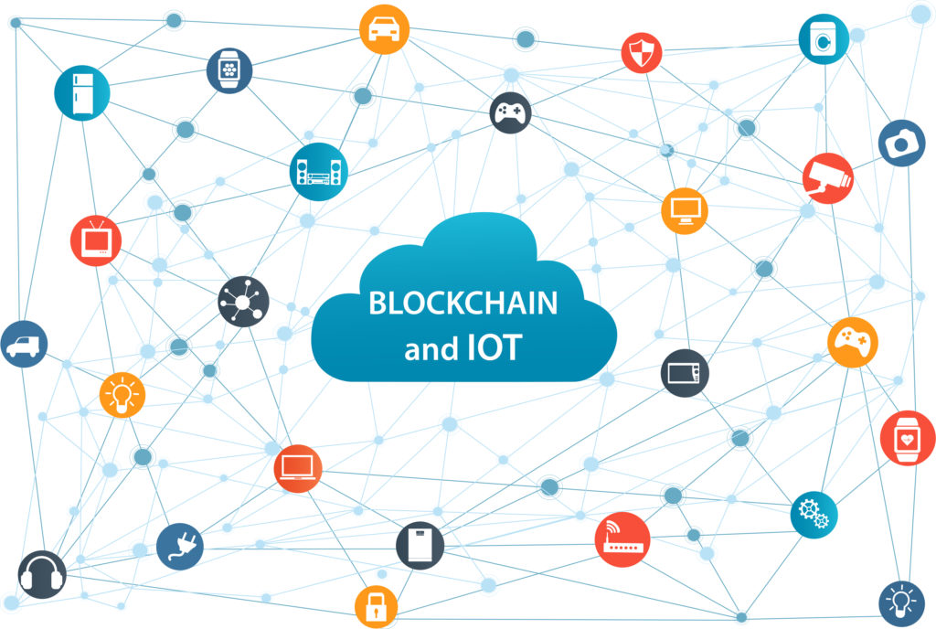
02
SOLUTION
Using Blockchain technology and IoT in Logistics and supply chain to solve above problems

Slide 7
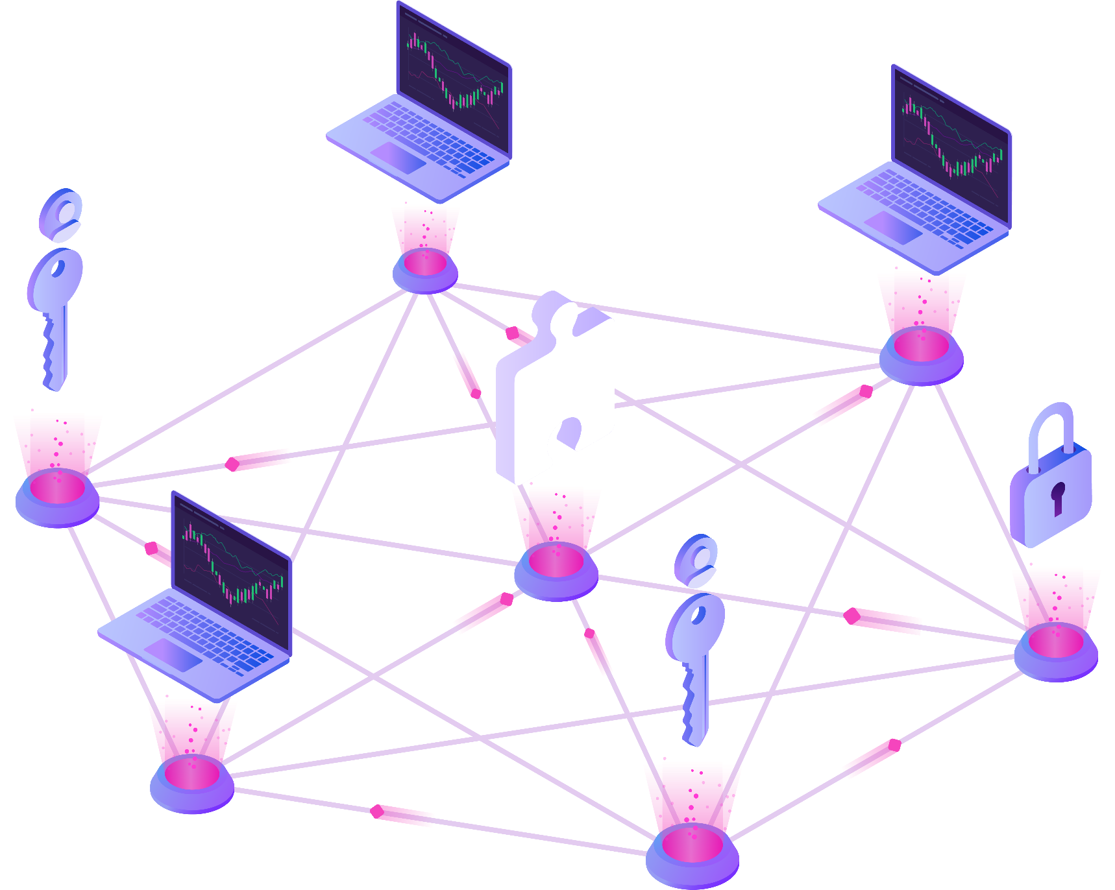

Blockchain
How it works?
A blockchain, originally block chain, is a continuously growing list of records, called blocks, which are linked and secured using cryptography. Each block typically contains a cryptographic hash of the previous block, a timestamp and transaction data.

Slide 8
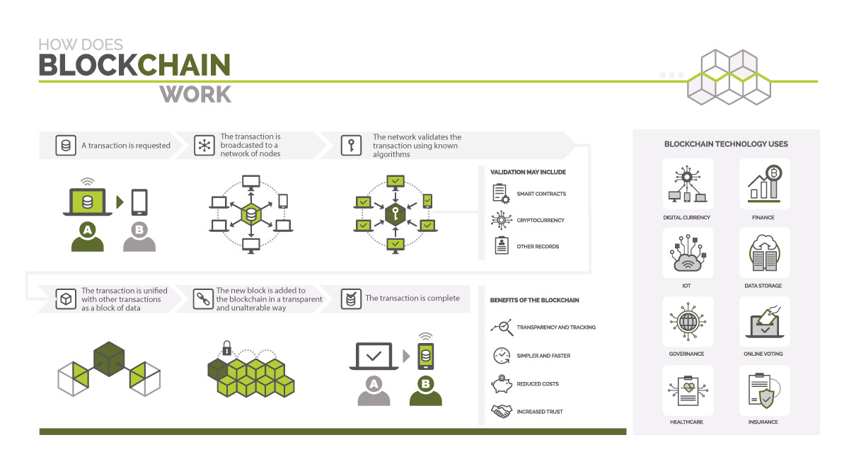

Slide 9

Immutability
Smart contracts
Immutability, in the context of the blockchain, means that once something has been entered into the blockchain, it cannot be tampered with.
Distributed ledgers enable the coding of simple contracts that will execute when specified conditions are met.
Transparent
Better Security
By making the results fully transparent and publicly accessible, distributed database technology could bring full transparency to elections or any other kind of poll taking.
Blockchain technology has a better security because there is not even a single chance of shutting down of the system. Even the highest level of the financial system are subject to get hacked.

Slide 10
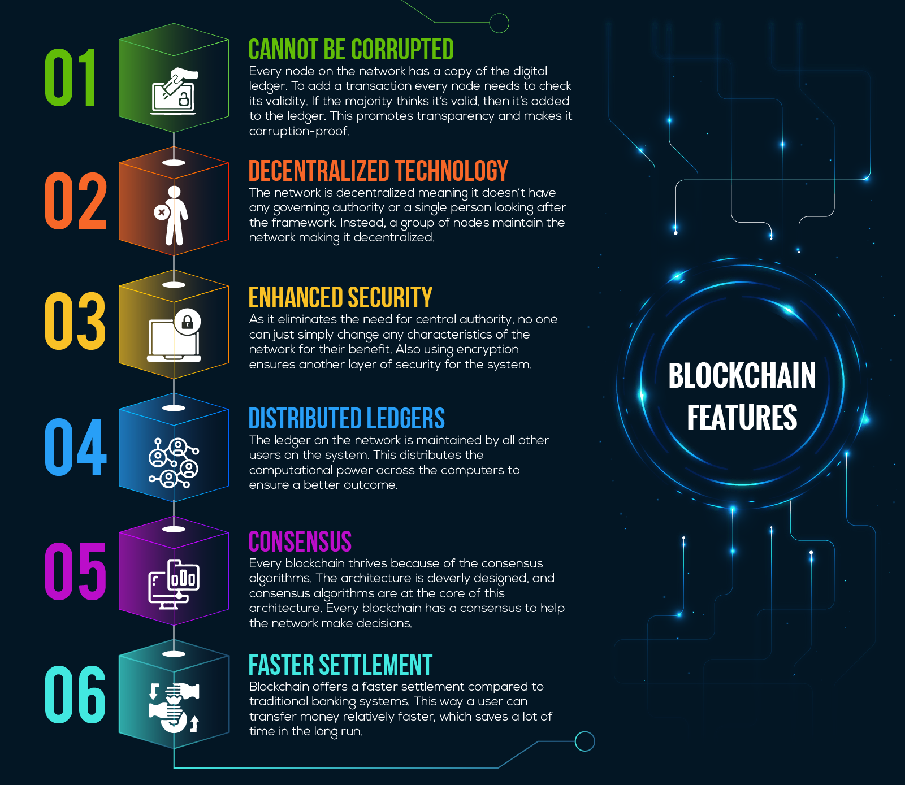
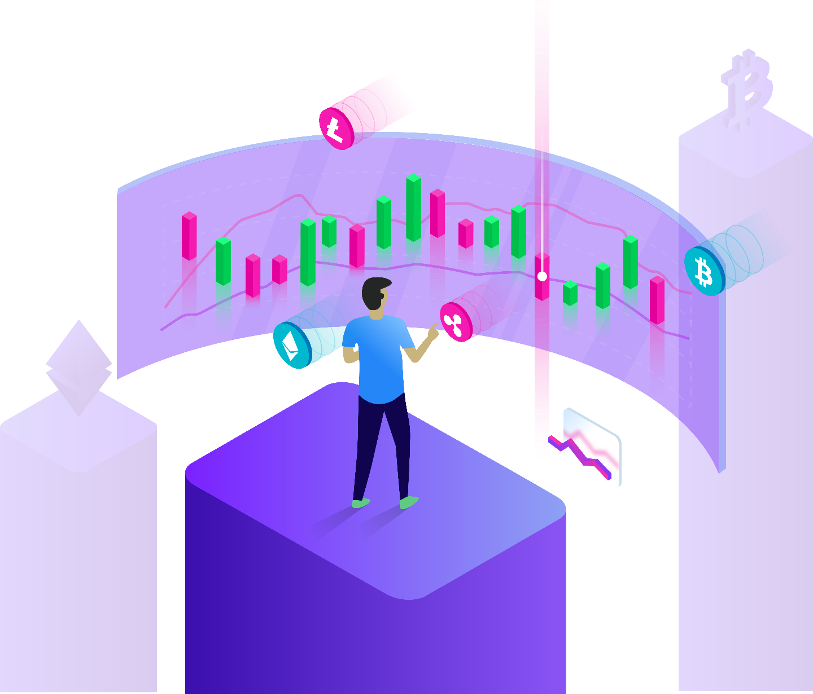
6 major key blockchain features

Slide 11



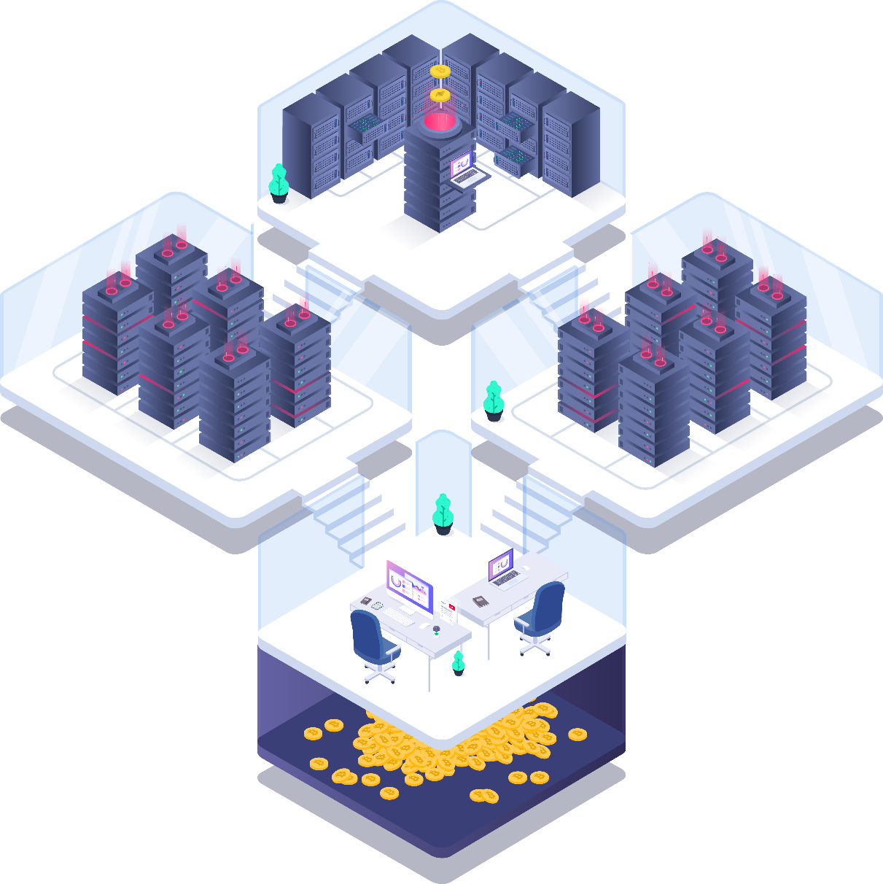
IOT AND BLOCKCHAIN INTEGRATION

Slide 12
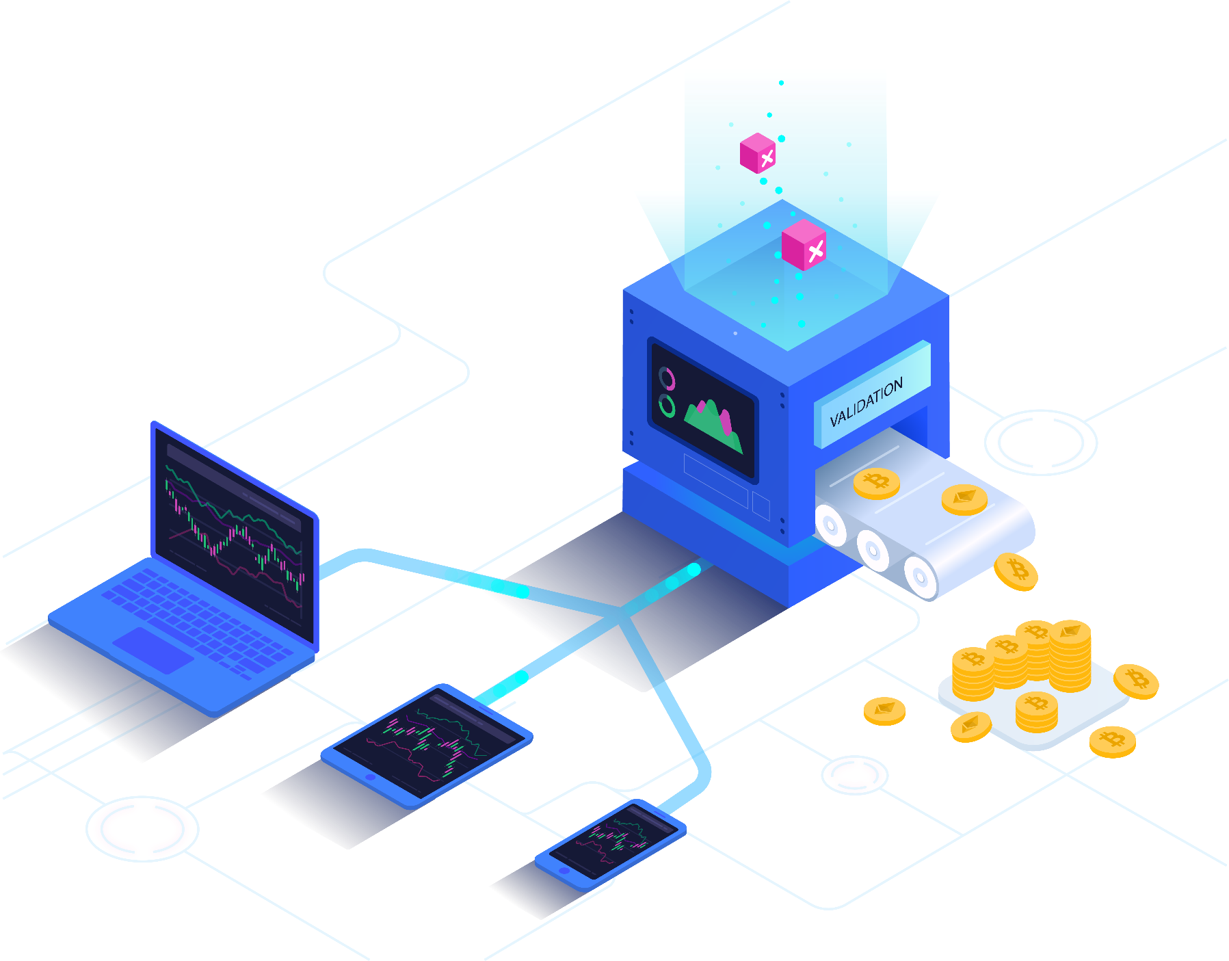

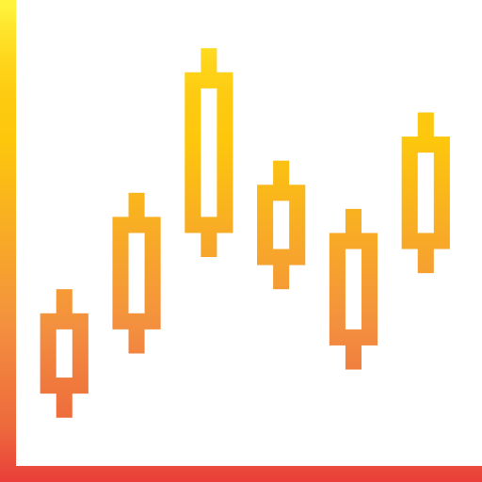
Internet of Things
Blockchain Technology
IoT Analytics predicts the global market for Internet of Things is expected to grow 15% from 2019 to $123B in 2021.
A Young Technology That Could Change Everything

Slide 13
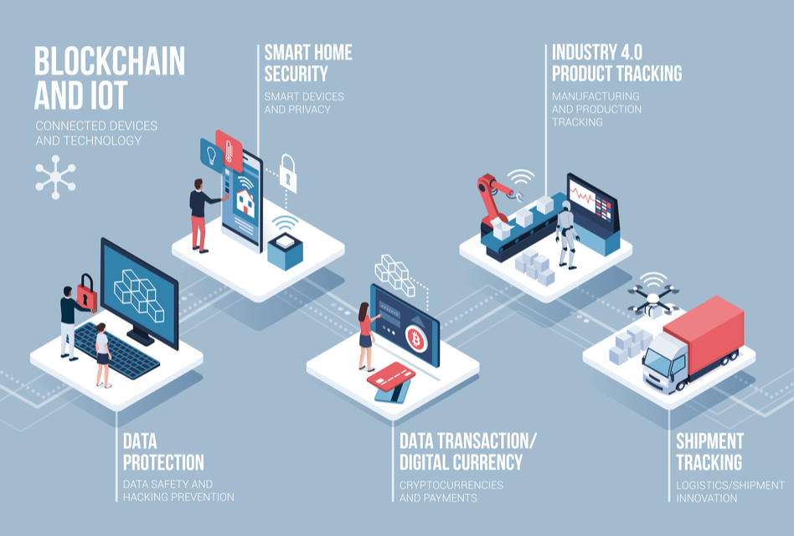
IoT Blockchain in many use cases

Slide 14
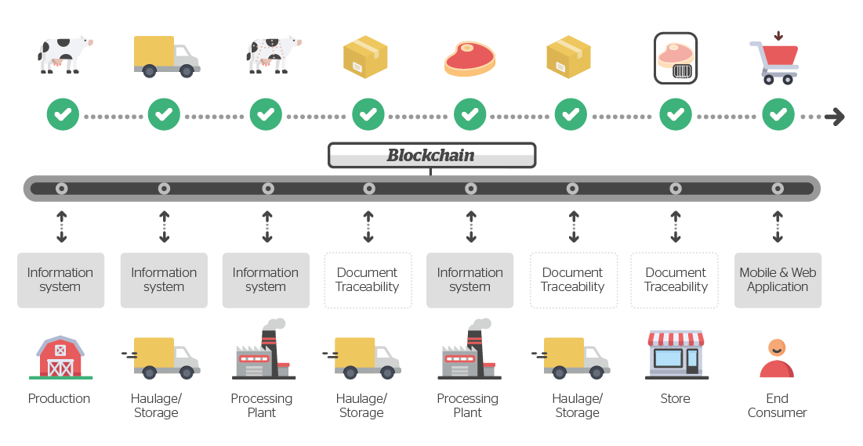
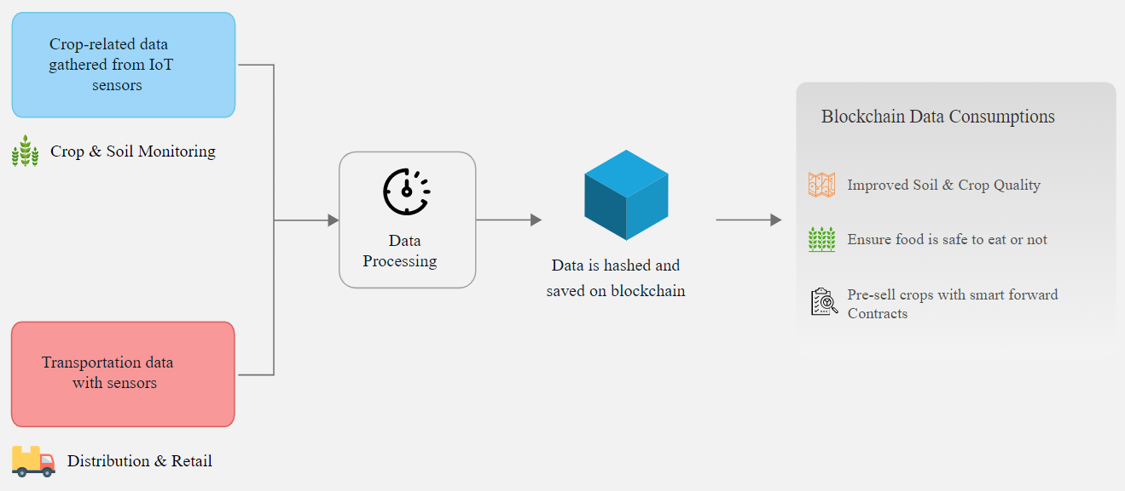
IoT Blockchain in food supply chain
IoT Blockchain in the agricultural supply chain

Slide 15
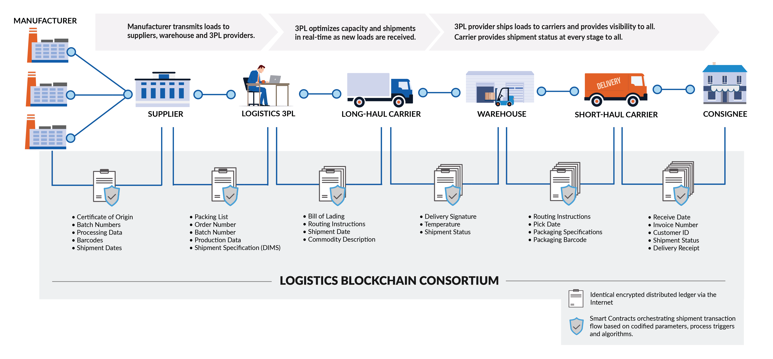
IoT Blockchain in LOGISTICS

Slide 16
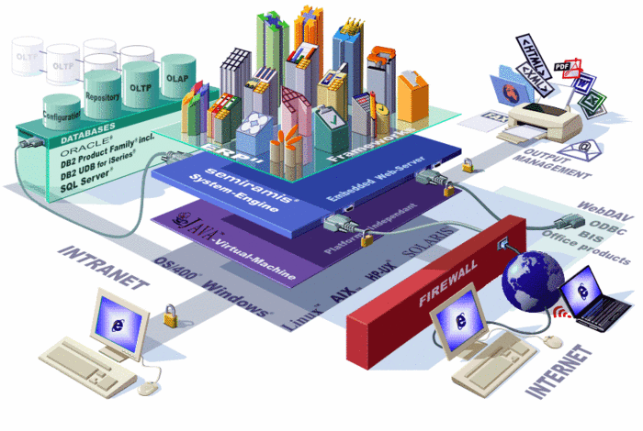
03
TECHNICAL ARCHITECTURE
Introduce about some frameworks, how to build a basic DApp (blockchain technology) and apply it to Logistics system.

Slide 17
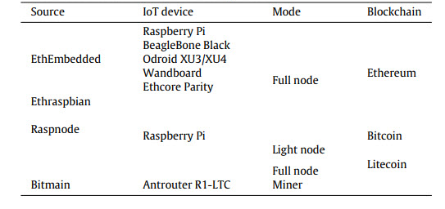
IoT devices to be used as blockchain components

Slide 18

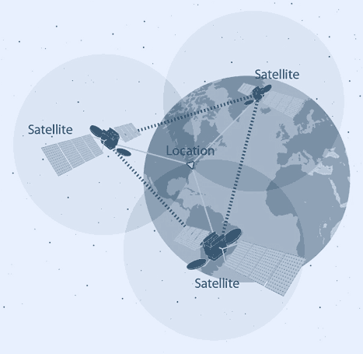
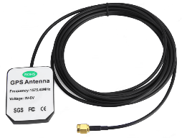
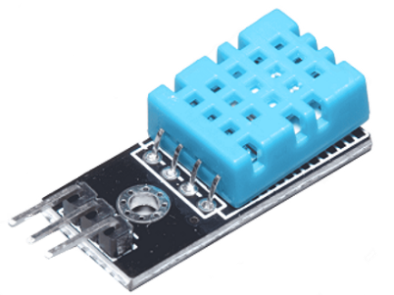

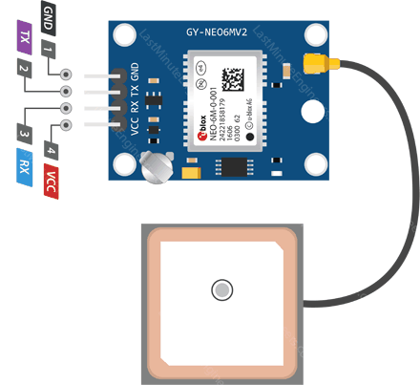

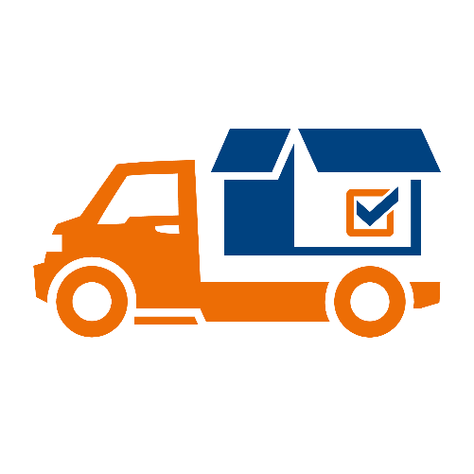
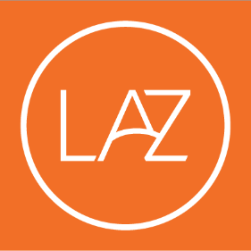
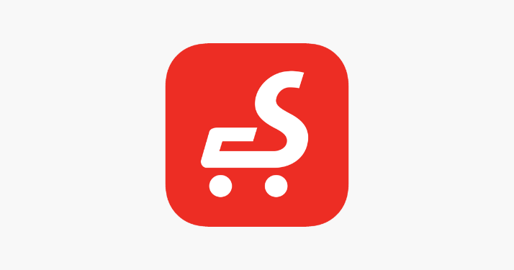

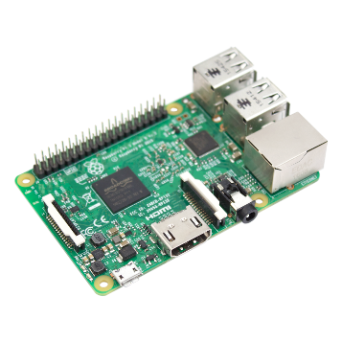





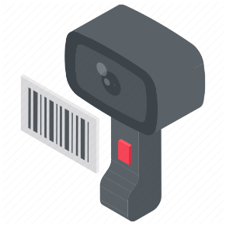
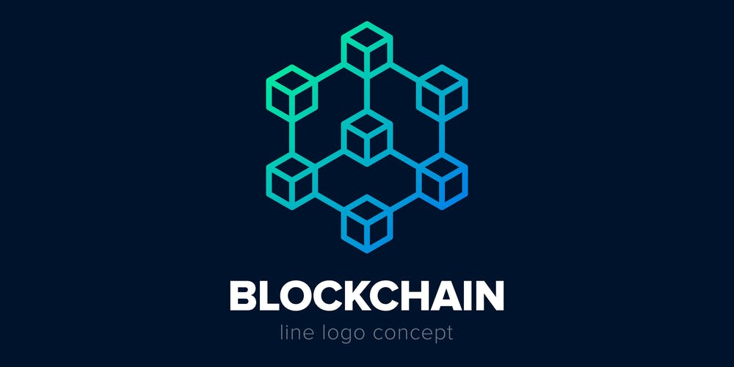
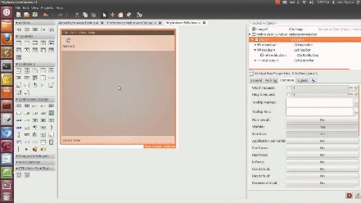



The sample model of project
Anten GPS 1575.42 MHz
Input from GUI
Module GPS U-Blox NEO 6-M
DHT11 Sensor
transport
import
Certificate of Origin
Certificate of Quality
Batch Numbers
Barcodes
Processing Data
Auto Detect
RaspNode #1
Shipment Dates
Location
Status: Temperature – Humidity
GUI
Barcode Scanner
RaspNode #n

Slide 19








The sample model
BASIC JAVA SWING GUI
BASIC INPUT INFORMATION
“WRITE ONCE – RUN ANYWHERE”

Slide 20

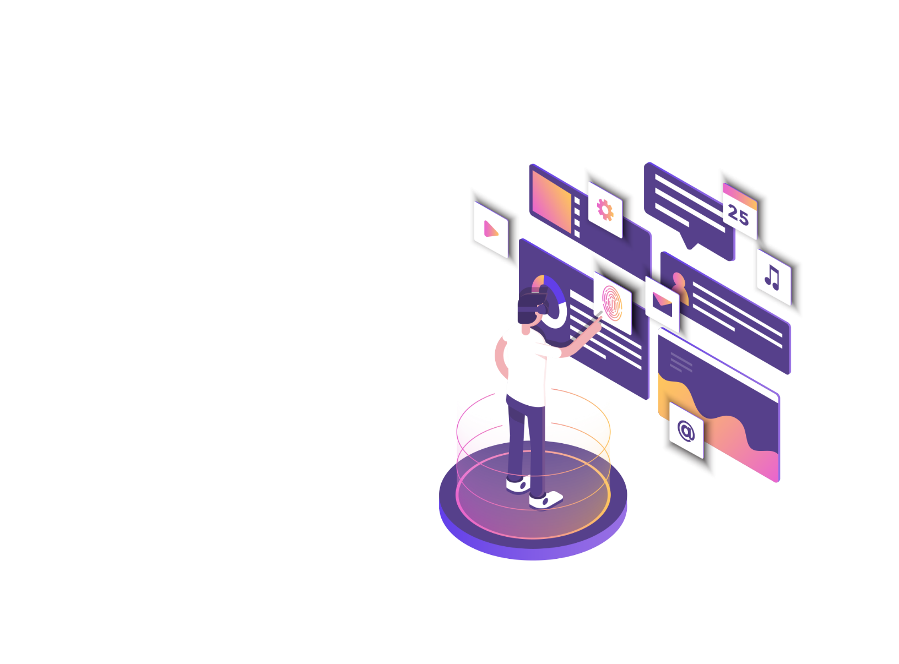
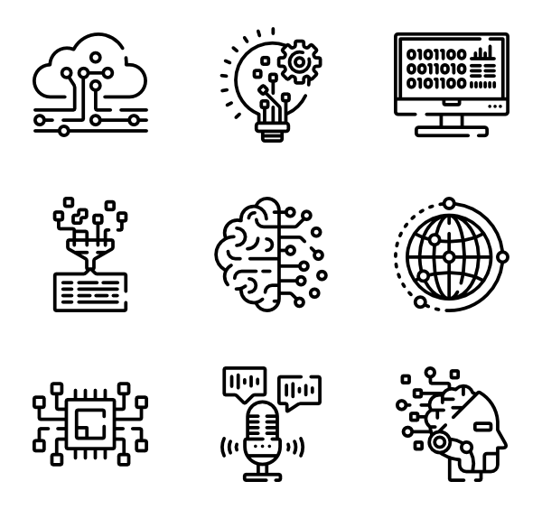

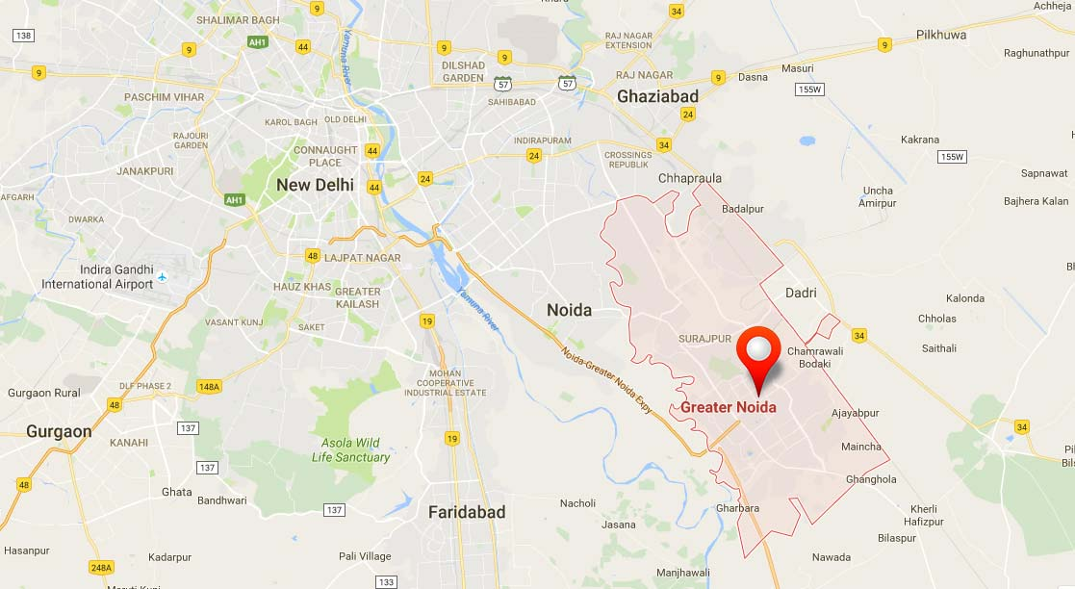
The sample model of project
PC – WEBSITE
Name
Origin
Real–time status | Temperature
 | Humidity
Other information
Real–time location:
CUSTOMER
MOBILE APP

Slide 21
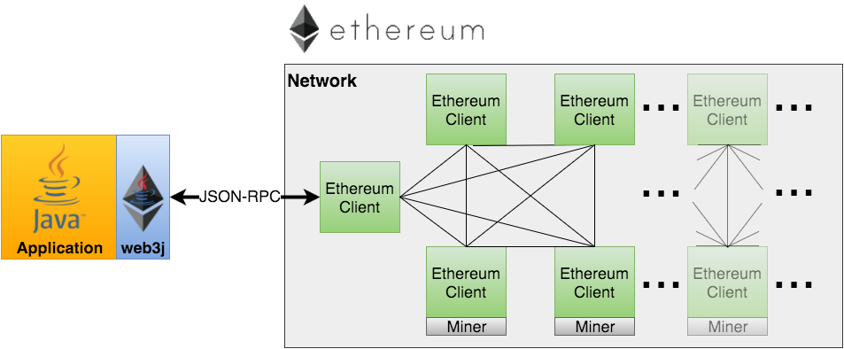
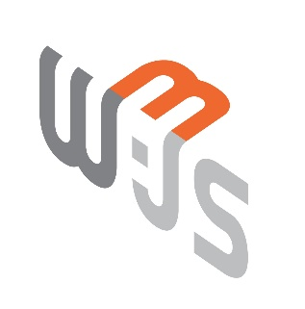
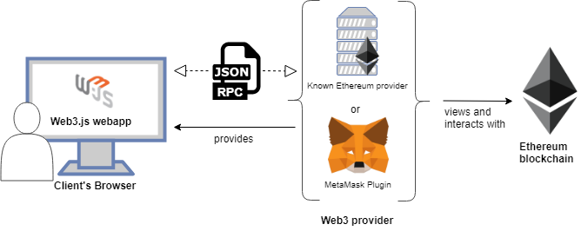


Slide 22
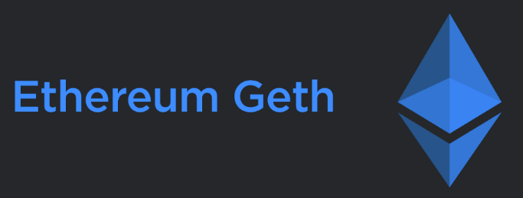
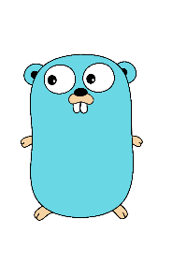
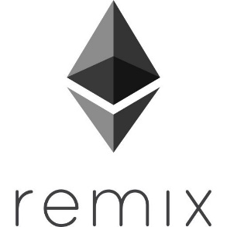
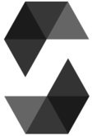
INTRODUCING ABOUT ETHEREUM
Geth
Geth = Go + Ethereum Geth is a popular client that provide the command line interface for running a full ethereum node in 'Go'.
Golang
A programming language for running and controlling Ethereum node.
Remix – Ethereum IDE
Solidity
Solidity was influenced by C++, Python and JavaScript and is designed to target the Ethereum Virtual Machine (EVM). https://remix.ethereum.org
Solidity is an object-oriented, high-level language for implementing smart contracts. Smart contracts are programs which govern the behaviour of accounts within the Ethereum state.

Slide 23

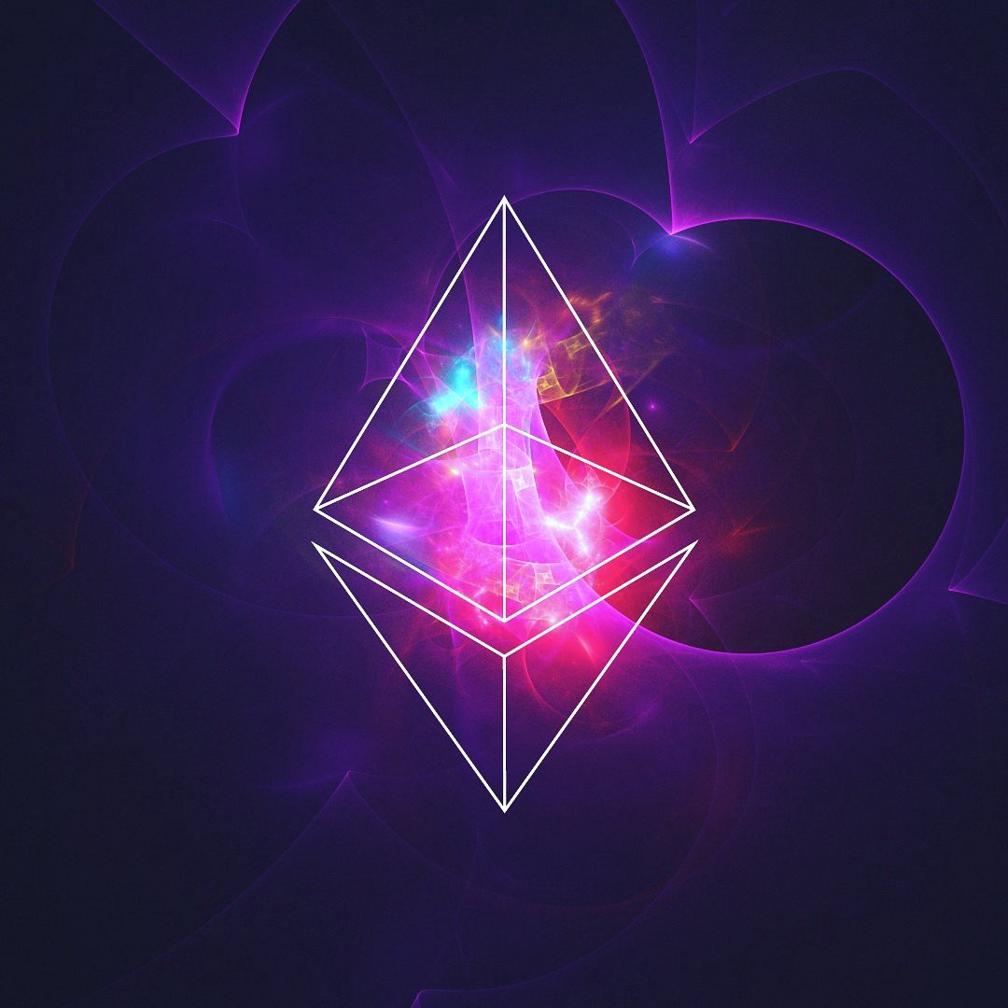
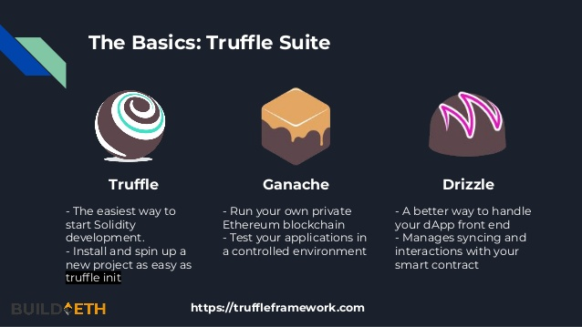

Slide 24
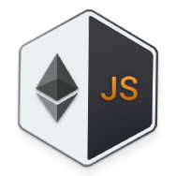





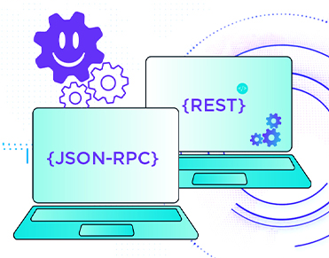
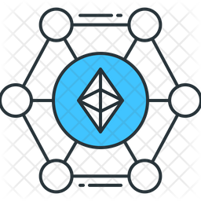
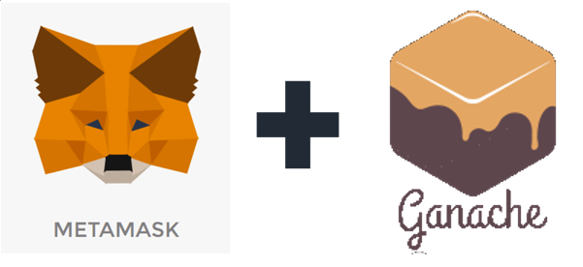
Ethereum JavaScript API
Smart Contract
based on
file smartcontract.sol
file .js
config.js
Web3.js
Web3.js
form & locate
connect
port / host key
Ethereum Blockchain for developer
JSON RPC
port / host key EthBlockchain
manage accounts / wallets
create
transact

Slide 25
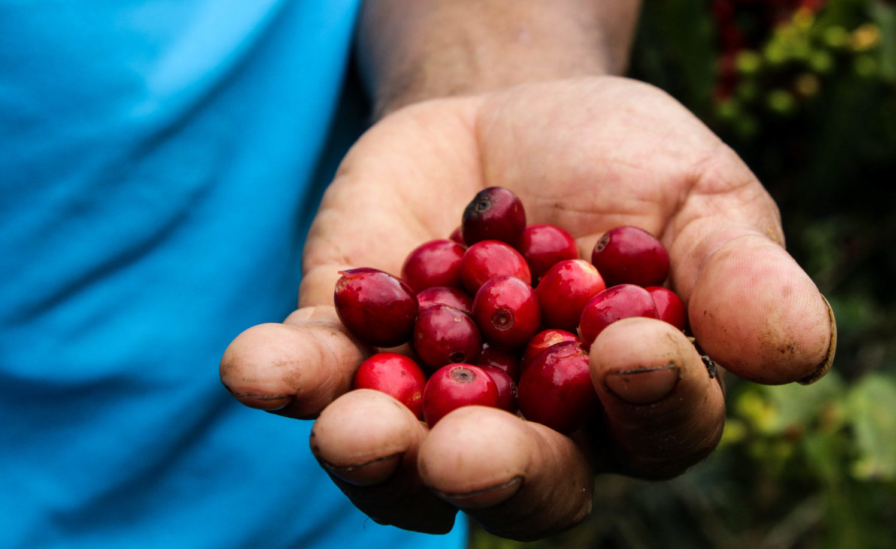


Result – Some others value

Slide 26

04
DISCUSSION – Q&A
QUESTIONS AND ANSWERS

Slide 27


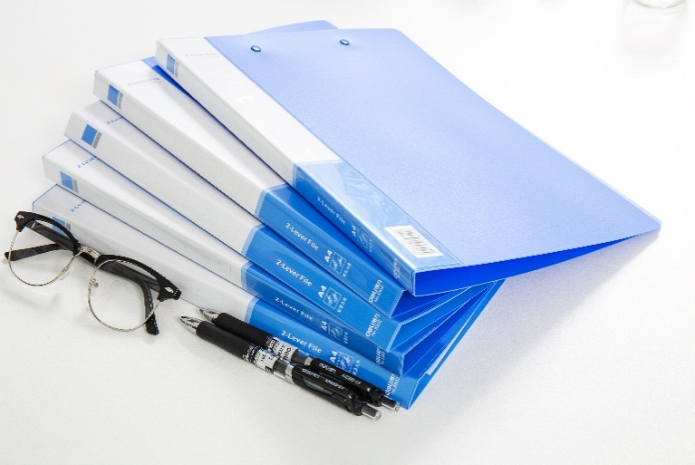

REFERENCE MATERIAL
SOURCE
[ 1 ] Ana Reyna *, Cristian Martín, Jaime Chen, Enrique Soler, Manuel Día – On blockchain and its integration with IoT – Challenges and
opportunities
[ 2 ] Continuous interconnected supply chain – Using Blockchain & Internet-of-Things in supply chain traceability
ONLINE SOURCE
[ 3 ] What is Blockchain Technology? A Step-by-Step Guide For Beginners https://blockgeeks.com/guides/what-is-blockchain-technology/
[ 4 ] Blockchain IoT Use Cases https://www.leewayhertz.com/blockchain-iot-use-cases-real-world-products/
[ 5 ] Wikipedia – Bitcoin, Blockchain
https://en.wikipedia.org/wiki/Bitcoin https://en.wikipedia.org/wiki/Blockchain

Slide 28

Tech Day 2019
THANK YOU
FOR YOUR LISTENING
Presented by: Thanh Tung – Thanh Phuong
DC17 – R&D Team

